Slide 1
B-H Analytical Solution to YPR Equation
The biological or life history parameters affecting the potential maximum biomass and the timing of the maximization are:
K is the instantaneous growth coefficient,
M is the instantaneous natural mortality coefficient, and
W∞ is the maximum weight an individual fish may attain.
The fishery related factors affecting the maximum potential yield are:
    tc is the age at which the fish enter the fishery (controlled by mesh size in a trawl fishery),
F is the instantaneous fishing mortality coefficient.

Slide 2
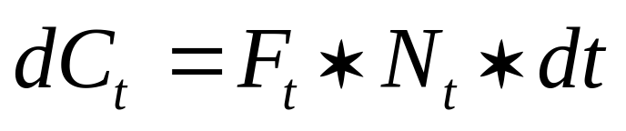
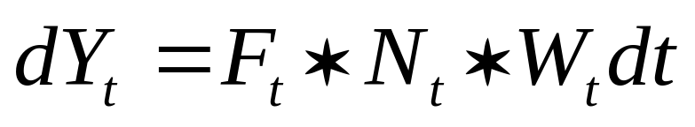
If R recruits from a cohort at time t = 0, then the numbers of fish caught (dC_{t}) and the yield in weight (dY_{t}) from that catch can be defined in short time intervals (t, t + dt) by:
where Nt is the number of fish alive at age t,
Ft is the fishing mortality coefficient, which may vary with age,
Wt is the average weight of an individual fish at age t.

Slide 3
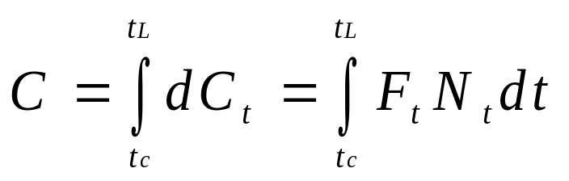
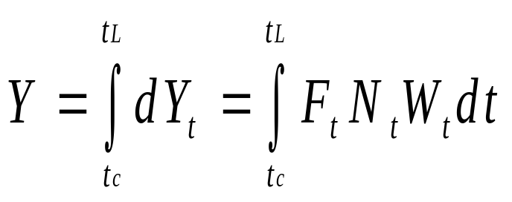
The total catch in numbers (C) from a cohort or yield in weight (Y) results from the integration of the previous differential equations from the age at which the fish remaining in the cohort enter the fishery (t_{c}) to some limiting age t_{L}.

Slide 4





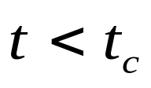
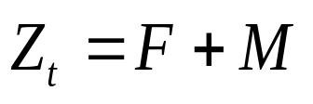
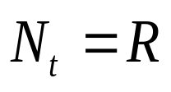

Making the following assumptions simplifies the problem:
and
constant for
for
for
for
where Zt is the total mortality coefficient, and
R is the total number of recruits in the cohort.

Slide 5

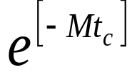

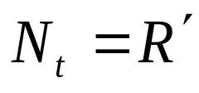
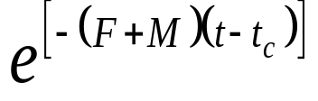

If is the number of fish recruiting to the fishery at time t = t_{c},
And
Then
for

Slide 6
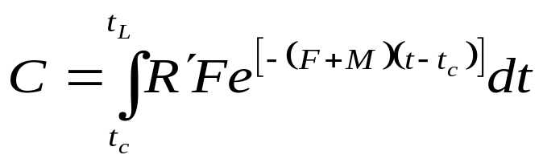




Thus the total number caught is:
ignoring the last term if

Slide 7
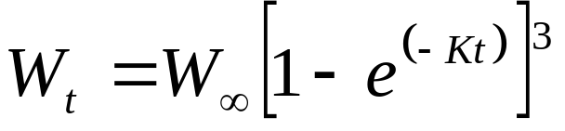
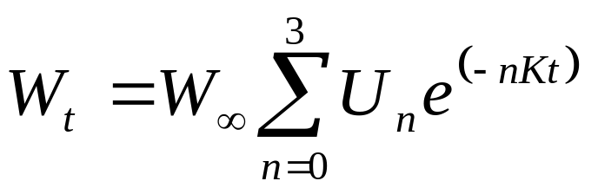
Yield = (Catch)*(Weight)
So:
And expanding:
where Uo = 1, U1 = ‑3, U2, = 3, U3, = -1

Slide 8
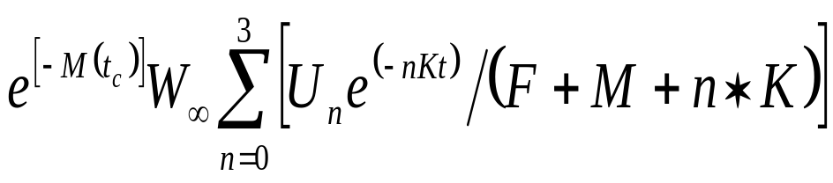
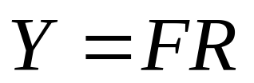
Simplified Yield Equation
So:

Slide 9
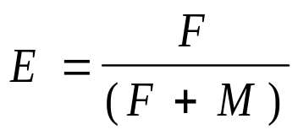
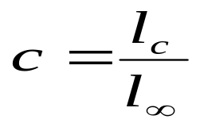
The yield equation is separated into two parts that characterize the fish stock as a constant and the fishing as a variable.
Exploitation Ratio:
Relative Size at First Capture:

Slide 10
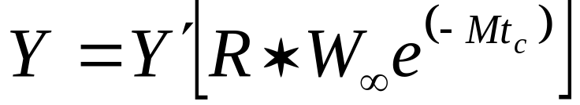
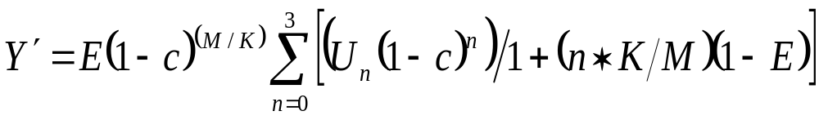
Final Yield Equation
Yield:
Where:

Slide 11
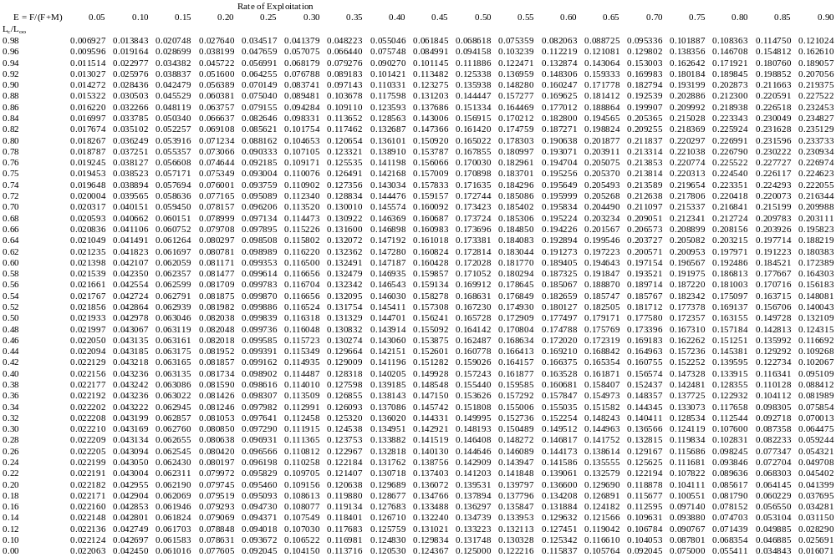
Yield per Recruit for M/K=0.5

Slide 12
M/K Ratio
For small M/K ratio (0.5), maximum yield is achieved at higher values of c (L_{c}/L∞). The implication is that fish are growing faster than they are dying, so management strategy to maximize yield is to harvest at a relatively larger size.
For large M/K ratios (2.0), maximum yield is achieved at lower values of c (L_{c}/L∞). The implication is that fish are dying faster than they are growing, so management strategy to maximize yield is to harvest at relatively smaller size.

Slide 13
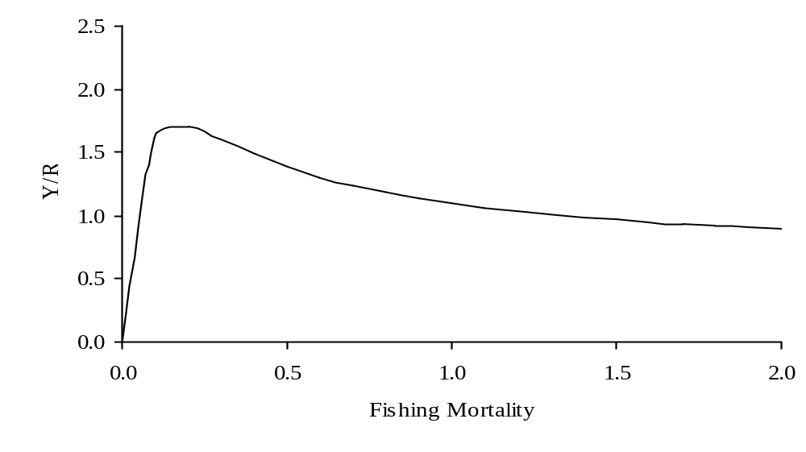
YPR as a function of F
M=0.1, W∞=10, K=0.2, t₀=0, t_{c}=3, t_{r}=0, Nt_{r}=100000, t_{y}=20, M/K=0.50

